Slide 1
Bias
Brian Caffo, Jeff Leek, Roger Peng
@bcaffo
www.bcaffo.com

Slide 2
Review
Randomization - using random assignment of a treatment to create balanced comparisons with high probability
A/B testing - implementation of randomization in an experiment
Causal Inference - trying to infer cause and effect using statistics

Slide 3
Inference
Statistical inference - the process of making conclusions about populations from a sample

Slide 4
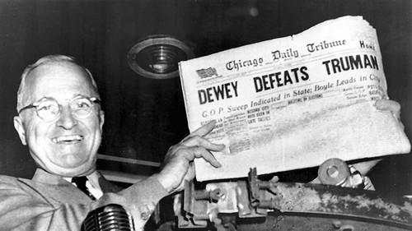
Example, election polling

Slide 5

Example, Kinsey report

Slide 6
How do we combat sampling and other forms of bias?

Slide 7
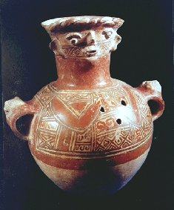
Random Sampling
http://commons.wikimedia.org/wiki/File:Maya_funerary_urn.jpg#/media/File:Maya_funerary_urn.jpg

Slide 8
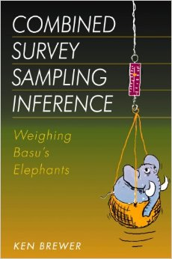
Reweighting

Slide 9
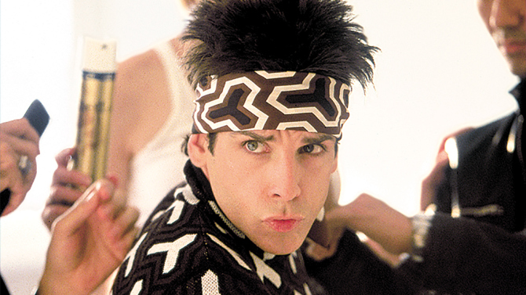
Modeling

Slide 10
Summary
Summary
Bias comes in many forms to contaminate analyses
Sampling bias is a particularly common one whereby your sample isn’t indicative of the population you’d like to make inferences about
Examples of strategies to combat sampling biases
Random sampling
Reweighting
Modeling

